Slide 1
CHAPTER - 5
Analog Transmission
Part-1

Slide 2

5.1 Digital-to-Analog conversion
Digital-to-analog conversion is the process of changing one of the characteristics of an analog signal based on the information in digital data. Figure shows the relationship between the digital information, the digital-to-analog modulating process, and the resultant analog signal.
Figure 5.1 Digital-to-analog conversion

Slide 3
Cont.
There are three mechanisms for modulating digital data into an analog signal:
  (1). Amplitude shift keying (ASK)
  (2). Frequency shift keying (FSK)
  (3). Phase shift keying (PSK)
In addition, there is a fourth (and better) mechanism that combines changing both the amplitude and phase, called quadrature amplitude modulation (QAM).
QAM is the most efficient of these options and is the mechanism commonly used today.

Slide 4

Cont.
Figure 5.2 Types of digital-to-analog conversion

Slide 5
5.1.1 Aspects of Digital-to-Analog Conversion
Before we discuss specific methods of digital-to-analog modulation, two basic issues must be reviewed: bit and baud rates and the carrier signal.
Data element versus signal element
A data element is the smallest entity that represent a piece of information; this is the bit.
In digital communications, a signal element carries data element.
A signal elements is the shortest unit (timewise) of a digital signal.

Slide 6
Cont.
Data rate versus signal rate
Data/bit rate defines the number of data elements (bit) sent in 1s. The unit is bits per second (bps)
The signal rate is the number of signal elements sent in 1 s. The unit is baud.
In the analog transmission of digital data, the signal or baud rate is less than or equal to the bit rate.
    S = N×1/r bauds
    Where, S = Signal rate/baud rate,
    N = Data/Bit rate (bps) and
    r = The number of data bits per signal element.
    Or, Number of bits required for sample.
The value of r in analog transmission is r = log₂^{L}, where L is the type of signal elements, not the level.

Slide 7
Cont.
Example 5.1
An analog signal carries 4 bits per signal element. If 1000 signal elements are sent per second, find the bit rate.
Solution
  In this case, r = 4, S = 1000, and N is unknown. We can find the value of N from.
  S = N×1/r
  N = S×r = 100 × 4 = 400 bps

Slide 8
Cont.
Example 5.2:
An analog signal has a bit rate of 8000 bps and a baud rate of 1000 baud. How many data elements are carried by each signal element? How many signal elements do we need?
Solution: In this example, S = 1000, N = 8000, and r and L are unknown. We find first the value of r and then the value of L.
    S = N×(1/r)
    r = N/S = 8000/1000 = 8 bits/baud
    r=log₂^{L}
    L= 2^{r} =2⁸=256

Slide 9
Cont.
Bandwidth: The required bandwidth for analog transmission of digital data is proportional to the signal rate except for FSK, in which the difference between the carrier signals needs to be added. We discuss the bandwidth for each technique.

Slide 10
Carrier Signal
In analog transmission, the sending device produces a high-frequency signal that acts as a base for the information signal. This base signal is called the carrier signal or carrier frequency.
Digital information then changes the carrier signal by modifying one or more of its characteristics (amplitude, frequency, or phase).
This kind of modification is called modulation (shift keying).

Slide 11
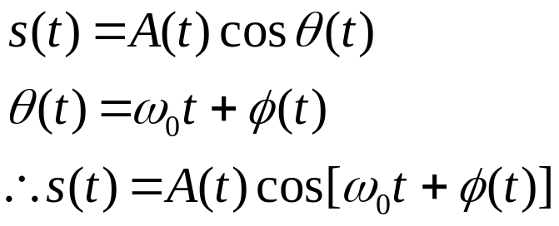
Cont.
A carrier signal has three parameters which can be used for impressing:
Amplitude
Frequency
Phase

Slide 12
Cont.
If the amplitude, A of the carrier is varied proportional to the information signal, a digital modulated signal is called Amplitude Shift Keying (ASK).
If the frequency, ω of the carrier is varied proportional to the information signal, a digital modulated signal is called Frequency Shift Keying (FSK).

Slide 13
Cont.
If the phase, θ of the carrier is varied proportional to the information signal, a digital modulated signal is called Phase Shift Keying (PSK).
If both the amplitude, A and the phase, θ of the carrier are varied proportional to the information signal, a digital modulated signal is called Quadrature Amplitude Modulation (QAM).

Slide 14
Cont.
Carrier: A sin[ωt +ϕ] | A = constant ω = constant ϕ = constant
Amplitude modulation (AM) | A = A(t) – carries information ω = constant ϕ = constant
Frequency modulation (FM) | A = constant ω = ω(t)– carries information ϕ = constant
Phase modulation (PM) | A = constant ω = constant ϕ = ϕ(t) – carries information

Slide 15
Amplitude Shift Keying
In amplitude shift keying, the amplitude of the carrier signal is varied to create signal elements.
Both frequency and phase remain constant while the amplitude changes.

Slide 16

Binary ASK (BASK)
Although we can have several levels (kinds) of signal elements, each with a different amplitude, ASK is normally implemented using only two levels.
  This is referred to as binary amplitude shift keying or on-off keying (OOK).
The peak amplitude of one signal level is 0; the other is the same as the amplitude of the carrier frequency.

Slide 17
Bandwidth for ASK
The bandwidth B of ASK is proportional to the signal rate S.
B = (1+d)S
Where,
    B= Bandwidth
    S = signal rate = N×(1/r)
    N = Data/Bit rate (bps) and
    d = 0 to 1, which depends on the modulation and filtering process.
    r = The number of data bits per signal element.
    Or, Number of bits required for sample.

Slide 18
Cont.
The formula shows that the required bandwidth has a minimum value of S and a maximum value of 2S.
The most important point here is the location of the bandwidth.
The middle of the bandwidth is where f_{c}, the carrier frequency, is located. This means if we have a bandpass channel available, we can choose our f_{c} so that the modulated signal occupies that bandwidth.

Slide 19
Cont.
For half-duplex
For full-duplex
Amplitude
Amplitude
F_{C}
F_{C1}
F_{C2}
F_{C}
F_{L}
F_{H}
Frequency
F_{L}
F_{H}
Frequency
F_{C} = (F_{L}+F_{H})/2
F_{C1} = (F_{L}+F_{C})/2 For sender
F_{C2} = (F_{C}+F_{H})/2 For receiver

Slide 20
Implementation
If digital data are presented as a unipolar NRZ digital signal with a high voltage of 1V and a low voltage of 0V, the implementation can achieved by multiplying the NRZ digital signal by the carrier signal coming from an oscillator.
When the amplitude of the NRZ signal is 1, the amplitude of the carrier frequency is held; when the amplitude of the NRZ signal is 0, the amplitude of the carrier frequency is zero.

Slide 21

Cont.
Bit 1 = Amplitude same as carrier signal.
Bit 0 = Amplitude 0.
Figure 5.4 Implementation of binary ASK

Slide 22
Cont.
After modulation we get a non periodic composite signal whose bandwdith is propotional to baud rate.
B∝ S
Or B = (1+d) S
Where, d is the factor for modulation and filtering process and its value range between 0 and 1.
    Best case, d=0 hence B=S
    Worst case, d=1 hence B=2S

Slide 23
Cont.
Example 5.3
We have an available bandwidth of 100 kHz which spans from 200 to 300 kHz. What are the carrier frequency and the bit rate if we modulated our data by using ASK with d = 1?
Solution
The middle of the bandwidth is located at 250 kHz. This means that our carrier frequency can be at f_{c} = 250 kHz. We can use the formula for bandwidth to find the bit rate (with d = 1 and r = 1).
B = (1+d) × S= (1+1) × N × (1/r) = 2 × N
N = B/2 = 100/2 =50 kbps

Slide 24

Cont.
Example 5.4
In data communications, we normally use full-duplex links with communication in both directions. We need to divide the bandwidth into two with two carrier frequencies, as shown in Figure 5.5. The figure shows the positions of two carrier frequencies and the bandwidths. The available bandwidth for each direction is now 50 kHz, which leaves us with a data rate of 25 kbps in each direction.
Figure 5.5 Bandwidth of full-duplex ASK used in Example 5.4

Slide 25
Multilevel ASK
The above discussion uses only two amplitude levels.
We can have multilevel ASK in which there are more than two levels.
We can use 4, 8, 16, or more different amplitudes for the signal and modulate the data using 2, 3, 4, or more bits at a time.
In these cases, r = 2, r = 3, r = 4, and so on.
Although this is not implemented with pure ASK, it is implemented with QAM (as we will see later).

Slide 26

Frequency Shift Keying
In frequency shift keying, the frequency of the carrier signal is varied to represent data.
The frequency of the modulated signal is constant for the duration of one signal element, but changes for the next signal element if the data element changes.
Both peak amplitude and phase remain constant for all signal elements.

Slide 27
Binary FSK (BFSK)
In binary FSK (BFSK), we can consider two carrier frequencies, f₁ and f₂. We use the first carrier if the data element is 1; we use the second if the data element is 0.
For example, a “1” could be represented by f₁ = f_{c}+ Δf, and a “0” could be represented by f₂ =f_{c}- Δf.

Slide 28
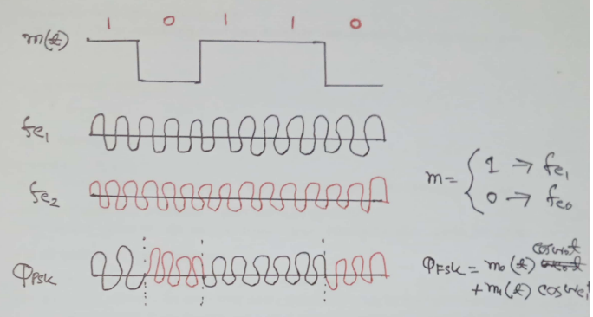
Cont.

Slide 29
Bandwidth for BFSK
semester
The carrier signals are only simple sine waves, but the modulation creates a nonperiodic composite signal with continuous frequencies.
We can think of FSK as two ASK signals, each with its own carrier frequency (f₁ or f₂). If the difference between the two frequencies is 2Δf , then the required bandwidth is B = (1+d) × S +2Δf.

Slide 30
Cont.
B = (1+d) × S +2Δf.
Where,
    d = 0 to 1, which depends on the modulation and filtering process.
    S = signal rate = N×(1/r) and
    B= Bandwidth
    f₁=f_{c} +Δf, f₂=f_{c}-Δf.
    Δf = f₁- f₂ = f_{c} +Δf – (f_{c}-Δf)
= f_{c} +Δf – f_{c}+Δf = 2 Δf

Slide 31
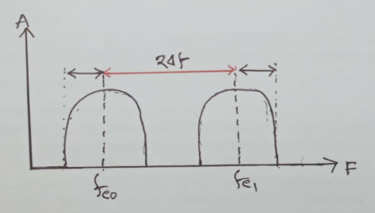
Cont.
Total bandwidth of FSK
= ((1+d) × S)/2 + ((1+d) × S)/2 + 2Δf
= (1+d) × S + 2Δf

Slide 32
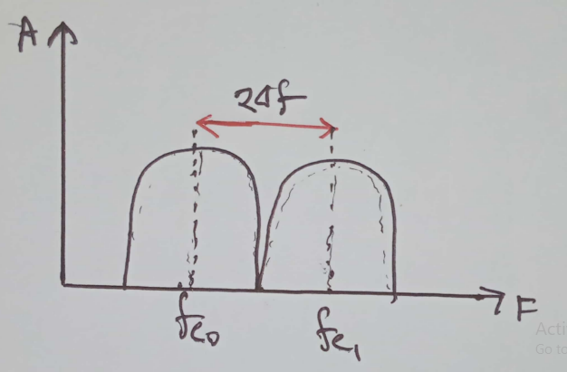
Cont.
For minimum bandwidth of FSK (d = 0)
2Δf = ((1+d) × S)/2 + ((1+d) × S)/2
2Δf = (1+d) × S
2Δf = (1 + 0) × S = S
Minimum bandwidth = (1+d) × S + 2Δf = (1+0)S + S = 2S

Slide 33
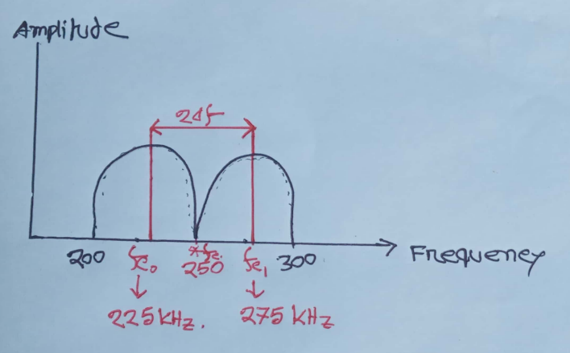
Cont.
Semester
Example 5.5
We have an available bandwidth of 100 kHz which spans from 200 to 300 kHz. What should be the carrier frequency and the bit rate if we modulated our data by using FSK with d = 1?

Slide 34
Cont.
Solution:
B= 100KHz, 2Δf =275-225=50KHz
B = (1+d) × S +2Δf
or 100 = (1+1) × S + 50 = 2S +50
or, 2S=50
or, S=25 kbaud
S = N×(1/r)
or, N = r × S = 1 × 25 = 25kbps
Compared to Example 5.3, we can see the bit rate for ASK is 50 kbps while the bit rate for FSK is 25 kbps.
    r =log₂^{L}
    r = log₂² = 1

Slide 35
Implementation
semester
There are two implementations of BFSK:
(1). Noncoherent and (2). Coherent.
In noncoherent BFSK, there may be discontinuity in the phase when one signal element ends and the next begins.
In coherent BFSK, the phase continues through the boundary of two signal elements.
Noncoherent BFSK can be implemented by treating BFSK as two ASK modulations and using two carrier frequencies.
Coherent BFSK can be implemented by using one voltage-controlled oscillator (VCO) that changes its frequency according to the input voltage.

Slide 36

Cont.
Figure 5.7 shows the simplified idea behind the second implementation. The input to the oscillator is the unipolar NRZ signal. When the amplitude of NRZ is zero, the oscillator keeps its regular frequency; when the amplitude is positive, the frequency is increased.
Figure 5.7 Bandwidth of MFSK used in Example 5.6

Slide 37
Multilevel FSK
For BFSK,
    L = 2, r =log₂² = 1, f_{c0} , f_{c1}
Multilevel FSK
    L = 4 = r =log₂⁴ = 2, f_{c0} , f_{c1} , f_{c2} , f_{c3}
    L = 8 = r =log₂⁸= 3, f_{c0} ,…….. , f_{c7}
For L Level, FSK bandwidth
    Bandwidth = (1+d) × S +(L-1) × 2Δf
    Minimum Bandwidth (d=0)
    = (1+d) × S +(L-1) × 2Δf
    = (1+0) × S +(L-1) × S
    = S + L × S – S = L × S

Slide 38
Multilevel FSK
Multilevel modulation (MFSK) is not uncommon with the FSK method. We can use more than two frequencies. For example, we can use four different frequencies f1, f2, f3, and f4 to send 2 bits at a time. To send 3 bits at a time, we can use eight frequencies. And so on. However, we need to remember that the frequencies need to be 2Δf apart. For the proper operation of the modulator and demodulator, it can be shown that the minimum value of 2Δf needs to be S. We can show that the bandwidth d = 0 is
B = (1+d) × S +(L-1) × 2Δf
B = L × S
Note that MFSK uses more bandwidth than the other techniques; it should be used when noise is a serious issue.

Slide 39
Cont.
semester
Example 5.6: We need to send data 3 bits at a time at a bit rate of 3 Mbps. The carrier frequency is 10 MHz. Calculate the number of levels (different frequencies), the baud rate, and the bandwidth.
Solution:
Given, r = 3 bit, N = 3 Mbps, f_{c} = 10 MHz,
Number of level, L= 2^{r} = 2³ = 8.
S = N×(1/r)
or, S = N/r = 3 Mbps/3 bits = 1 Mbaud.
B = (1+d) × S +2Δf
Minimum bandwidth, B = L × S = 8 × 1 = 8 MHz.

Slide 40
Real life Application of
Digital-to-Analog conversion
H.W

